Slide 1



Dataverse
Africa
African Financial Segmentation
Dashboard With NLP-enhanced Insights
TEAM: Amarachi F., Thato Maelane, Philip Odiachi, Mavis
Program: Dataverse Africa Internship - Cohort 3
DATE: January 9th, 2026

Slide 2

Executive Summary
This technical report presents the development and implementation of a comprehensive Customer Financial Intelligence Platform designed for African financial markets.
The platform addresses critical business challenges in customer segmentation, risk assessment, and digital transformation through an integrated analytics solution comprising three interconnected components, an automated data processing pipeline, an interactive Streamlit web application, and a comprehensive Power BI dashboard suite.
Dataverse
Africa

Slide 3
Key Distinction
The platform demonstrates unique versatility through dual data handling capabilities. The Power BI dashboards were built using the specific 5,200-record dataset provided by DataVerse Africa for the capstone project, delivering fixed, production-ready insights.
Conversely, the Streamlit application was engineered with adaptive intelligence to accept and analyze any customer dataset with similar characteristics, providing flexible, on-demand analytics capabilities.
Dataverse
Africa

Slide 4
The system successfully processed 5,200+ customer records, revealing significant business insights including a 40% high-risk customer concentration, 25% mobile application adoption rate, and geographic concentration of high-value customers in urban centers.
The platform delivers actionable intelligence through two complementary interfaces tailored to different use cases and data sources.
Dataverse
Africa

Slide 5

Introduction
Business Context
African financial institutions face unique challenges including diverse customer behaviors, varying digital adoption rates, and complex risk profiles.
Traditional analytics solutions often prove inadequate due to their limited adaptability to local contexts and reliance on standardized data structures.
This project addresses these limitations through a flexible, context-aware analytics platform specifically designed for African market dynamics.
Dataverse
Africa

Slide 6
Project Objectives
Development of an automated customer segmentation framework
Implementation of advanced sentiment analysis for unstructured feedback
Creation of predictive risk assessment capabilities
Design of user-friendly interfaces for different stakeholder groups
Establishment of a scalable analytics architecture supporting real-time insights
Dual-purpose system design: Fixed dashboard for provided dataset and flexible application for any customer dataset
Dataverse
Africa

Slide 7




Solution Architecture
The implemented solution comprises three integrated components
with distinct data handling capabilities:
Automated Analytics Pipeline
Interactive Web Application
Business Intelligence Dashboard Suite
Python-based data processing and machine learning models
Streamlit-based platform for flexible data exploration and analysis
Six interconnected Power BI dashboards for executive reporting on provided dataset

Slide 8
Methodology
A. Data Processing Framework
The analytical pipeline implemented automated data processing with
intelligent feature engineering, including:
Dynamic data type detection and validation
Advanced missing value imputation techniques
Feature transformation and normalization
Composite metric development for risk scoring and digital adoption indices

Slide 9
B. Machine Learning Implementation
Unsupervised learning methodologies were
employed for customer segmentation:
K-Means clustering with automated optimal cluster determination
Principal Component Analysis for dimensionality reduction
Feature importance analysis for segment interpretation
Cluster stability validation through multiple validation metrics

Slide 10
C. Natural Language Processing
Advanced sentiment analysis was conducted using VADER (Valence Aware Dictionary and sEntiment Reasoner), selected for its effectiveness with informal text and African linguistic patterns.
D. Validation Framework
Comprehensive validation protocols ensured analytical robustness through technical validation (cross-validation, algorithmic comparison) and business validation (domain expert alignment, practical applicability).

Slide 11



Platform Architecture & Components
A. Overall System Architecture
Three-Tier Analytics Platform Components
Tier 1: Data Processing Engine
Tier 2: Interactive Analysis Layer
Tier 3: Business Intelligence Layer
Data Ingestion & Validation
Feature Engineering Pipeline
Machine Learning Models
Model Management & Versioning
Streamlit Web Application
Real-time Data Processing
Interactive Visualization
Dynamic Insight Generation
Power BI Dashboard Suite (6 Dashboards)
Scheduled Reporting
Executive Summaries
Performance Monitoring

Slide 12
B. Data Sources and Processing Methodology
Power BI Dashboard Data Source
The Power BI dashboard suite was developed using the specific 5,200-record dataset provided by DataVerse Africa for the capstone project.
This dataset represents a comprehensive sample of African financial customer data with the following fixed characteristics:

Slide 13
Dataset Specifications:
Source: DataVerse Africa Capstone Project Dataset
Records: 5,200 customer profiles
Fixed Structure: Pre-defined columns and data types
Purpose: Demonstration of analytical capabilities on standardized data
Implementation: Static dashboard with pre-computed insights and visualizations

Slide 14
Key Features of Provided Dataset:
Customer demographic information
Financial transaction patterns
Credit scoring and risk indicators
Digital channel usage metrics
Customer feedback and sentiment data

Slide 15
Streamlit Application Data Handling
The Streamlit application was engineered with intelligent data adaptation capabilities to process any customer dataset with similar characteristics.
The system employs:
Adaptive Data Processing:
Automatic Column Recognition: Identifies key data categories regardless of column naming conventions
Dynamic Feature Engineering: Creates necessary metrics based on available data
Flexible Data Validation: Accommodates variations in data structure and quality
Intelligent Data Imputation: Handles missing values contextually based on column types

Slide 16
Required Data Characteristics for Streamlit App:
While flexible, optimal performance requires datasets containing:
Minimum Required Data:
Customer identification (ID, account number, etc.)
Financial metrics (spending amounts, credit scores, etc.)
Demographic information (age, location, etc.)
Behavioral data (transaction channels, categories, etc.)
Optional: Customer feedback text for sentiment analysis

Slide 17
Supported Data Formats:
CSV files with any column structure
Excel spreadsheets with multiple sheet support
JSON files with nested data structures
Direct database connections (advanced configuration)

Slide 18
Streamlit Web Application: Interactive Analysis Platform
The Streamlit application serves as the primary interface for data analysts and business users to interact with the analytics platform. It provides complete functionality for data upload, processing, analysis, and insight generation. Live app URL
Core Functionality:
Adaptive Data Recognition: Automatically identifies column types and relationships
Flexible Schema Handling: Works with various column naming conventions
Quality Assessment: Provides real-time feedback on data quality issues
Sample Generation: Creates demonstration datasets when no data is available

Slide 19
Navigation Structure:
01
02
03
Upload Data Section
Data Overview Section
Analysis Results Section
File upload with format validation
Data preview with quality metrics
Processing initiation controls
Dataset statistics and metadata
Column information and data types
Missing value analysis
Statistical summaries
Customer segment identification
Segment characteristics and profiles
Downloadable results in multiple formats
Cluster performance metrics
04
05
06
Visualizations Section
Insights Section
Recommendations Section
Interactive Plotly charts with hover details
Segment comparison visualizations
Geographic distribution maps
Time-based trend analysis
Automated natural language insights
Key finding summaries
Business implications analysis
Opportunity identification
Actionable strategy recommendations
Implementation roadmaps
Resource allocation guidance
Risk mitigation strategies

Slide 20
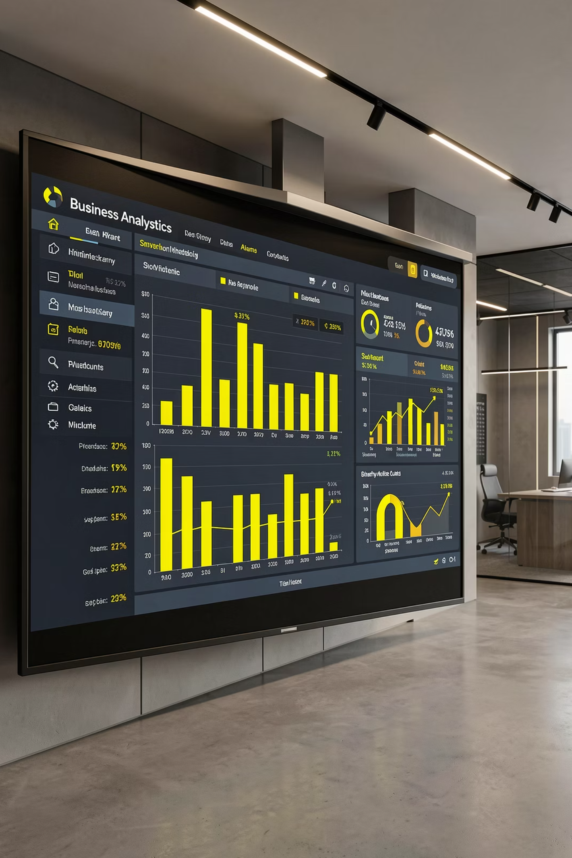
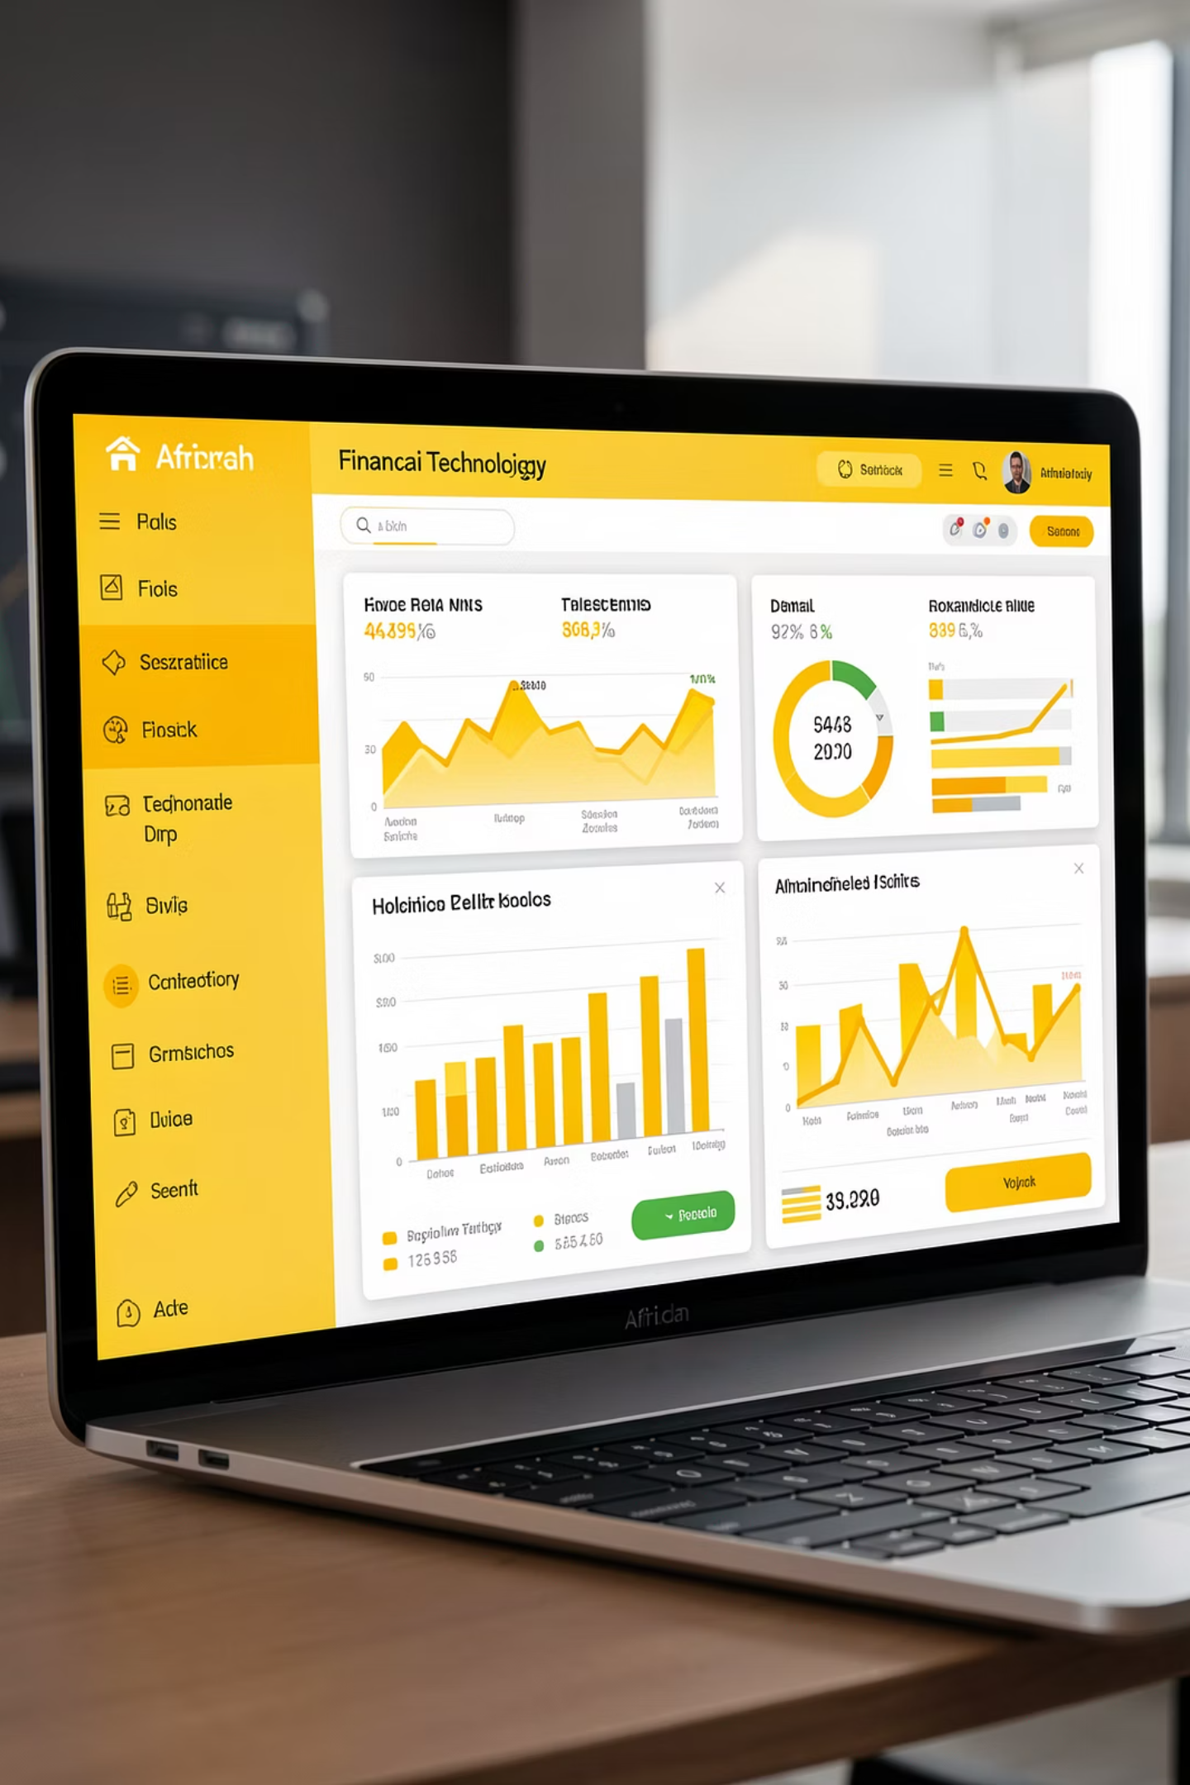
POWER BI DASHBOARD SUITE:
EXECUTIVE BUSINESS INTELLIGENCE
Dashboard Suite URL: https://bit.ly/45za0YJ

Slide 21


Dashboard Suite Overview
The Power BI dashboard suite provides executive-level reporting and monitoring capabilities through six interconnected dashboards, specifically built using the DataVerse Africa provided dataset. These dashboards represent fixed, production-ready insights derived from the standardized dataset.
African Financial Customer
Intelligence Dashboard
Customer Segments Analysis
Dashboard
Provides high-level overview of customer base and risk distribution based on provided dataset.
Analyzes geographic and behavioral distribution of customer segments from provided dataset.

Slide 22




Digital Transformation Dashboard
Financial Health Dashboard
Tracks digital adoption and channel usage patterns from provided dataset.
Monitors credit health and loan portfolio performance from provided dataset.
Voice of Customer Dashboard
Prediction Risk Dashboard
Analyzes customer sentiment and feedback patterns from provided dataset.
Identifies and monitors high-risk customers and default probabilities from provided dataset.

Slide 23
African Financial Customer Intelligence
Key Metrics:
Recommendations:
To mitigate risks, it is crucial to enhance customer education on credit management and financial health.
Initiating targeted campaigns that promote saving behaviors and responsible spending could be beneficial.
Additionally, developing personalized financial solutions tailored to the identified segments may foster better engagement and trust.
Total Customer Base: 5,200 individuals (from provided dataset)
Average Credit Score: 619.60
High-Risk Customer Percentage: 40%
Customer Segmentation Distribution
Insights:
The dashboard reveals a robust customer base of 5,200 individuals, categorized into distinct segments based on risk prediction and behavioral patterns.
Notably, the average credit score stands at 619.60, indicating room for improvement in financial literacy and credit management among customers.
The segmentation highlights that 40% of customers fall into the 'High Risk' category, which poses significant challenges for credit providers.
Conclusions:
By addressing the high-risk customer segments with focused strategies, the organization can improve overall financial health and customer relations. Enhanced customer understanding can lead to reduced default rates and increased financial inclusion.

Slide 24
Customer Segments Analysis
Recommendations:
Key Metrics:
To capitalize on this insight, a localized marketing strategy should be developed, focusing on urban centers where high spenders are concentrated.
Investing in digital tools to improve service delivery in these regions could strengthen customer loyalty and boost expenditure.
Geographic Distribution by Region
Average Digital Score: 1.00
High Spender Concentration Areas
Segment Performance Indicators
Insights:
This dashboard highlights a rich geographic representation of customer segments, with an average digital score of 1.00 across various regions.
The segmentation analysis shows a promising distribution, emphasizing that high spenders predominantly reside in urban areas such as Abuja and Lagos.
Conclusions:
Focusing efforts on high-spend areas while ensuring accessibility for lower segments can maintain balanced growth across customer groups.
By embracing targeted strategies, the potential for increased market penetration and customer satisfaction will be significantly enhanced.

Slide 25
Digital Transformation
Recommendations:
Key Metrics:
To drive digital adoption, investing in user-friendly mobile applications and marketing initiatives that educate customers on the benefits of digital transactions is vital.
Consider offering incentives for using the app, such as reduced fees or loyalty points.
Mobile App Usage Rate: 0.25
Average Digital Adoption Score: 0.26
Insights:
With a mobile app usage statistic of 0.25 and digital adoption showing an average score of 0.26, it is evident that there's a critical need for improved digital engagement.
The transactional channel distribution favors traditional methods, suggesting a reluctance from customers to embrace digital platforms fully.
Conclusions:
Elevating the customer experience through digital platforms can enhance operational efficiency and customer satisfaction.
A strategic push towards digital engagement will not only streamline transactions but also position the organization competitively in an increasingly digital marketplace.

Slide 26
Financial Health
Recommendations:
Encouraging financial education initiatives and offering tailored financial products could assist customers in improving their credit scores and overall financial health.
Regular workshops or online training sessions can actively engage customers in their financial journeys.
Insights:
The credit score distribution reveals a substantial number of customers with scores in the "Poor" to "Fair" categories, directly influencing their borrowing capacity.
Additionally, the analysis indicates that the overall loan portfolio stands at 2.1 billion, highlighting a significant driver for revenue.
Conclusions:
By focusing on enhancing customer credit health, the organization stands to minimize risks associated with lending while potentially increasing revenue through improved loan repayment rates.
This duality could create a more sustainable financial ecosystem.

Slide 27
Voice of Customer
Recommendations:
It's imperative to implement a robust complaint resolution mechanism, ensuring that customer feedback is not only acknowledged but acted upon.
Crafting a structured approach to customer service training can also enhance service interactions, subsequently improving sentiment.
Insights:
The sentiment analysis here shows an overall net negative sentiment of -0.10, with a high volume of negative feedback collected (2,205 instances).
Customers express grievances predominantly around service delivery, which indicates dissatisfaction that could adversely affect customer retention.
Conclusions:
By prioritizing customer feedback and demonstrating commitment to service improvement, the organization can reverse negative sentiment trends.
Engaged and satisfied customers are more likely to become advocates, transforming challenges into opportunities for growth.

Slide 28
Prediction Risk
Insights:
Recommendations:
Implementing advanced predictive analytics to identify at-risk customers proactively can pave the way for preemptive measures.
Customized support packages for these individuals could mitigate potential defaults and strengthen customer relationships.
The risk signal detection indicates a critical proportion of customers exhibiting high risk, with 148 identified as potentially defaulting.
This signals an urgent need to address these risk factors comprehensively.
Conclusions:
Adopting a proactive risk management strategy not only protects the financial integrity of the organization but positions it as a responsible lender.
By addressing the needs of high-risk customers, the organization can foster loyalty and ensure sustainable growth.

Slide 29

Integration and Data Flow: Dual Data Pipeline Architecture
STREAMLIT APPLICATION PATH
POWER BI DASHBOARD PATH
Any Customer Dataset (CSV/Excel/JSON)
DataVerse Africa Provided Dataset (Fixed)
↓
↓
Adaptive Data Processing Engine
Pre-processed Analytics & Visualizations
↓
↓
Dynamic Feature Engineering & Analysis
Fixed Dashboard Suite (6 Dashboards)
↓
↓
Real-time Insights & Recommendations
Executive Reporting & Performance Tracking
Consistency Assurance
Analytical Consistency: Both platforms use the same underlying algorithms and methodologies
Insight Quality: Comparable analytical rigor across both implementations
Methodological Alignment: Consistent application of machine learning and statistical techniques
Business Logic: Unified business rules and decision frameworks

Slide 30
Strategic Recommendations
Immediate Priority Actions (30-Day Implementation)
1
High-Risk Customer Intervention:
Targeted Financial Counseling: Implement personalized guidance programs for high-risk segments
Product Modification: Develop customized financial products addressing specific risk factors
Early Warning Systems: Establish automated monitoring for risk indicator changes
2
Medium-Term Strategic Initiatives (90-Day Implementation)
Segment-Specific Strategy Development:
Digital Adoption Acceleration:
Urban Center Focus: Implement localized strategies for high-value geographic segments
Product Portfolio Expansion: Develop tailored offerings for each customer segment
Channel Optimization: Reallocate resources based on usage patterns and effectiveness
User Experience Enhancement: Redesign digital interfaces based on feedback analysis
Incentive Programs: Introduce rewards for digital channel adoption
Education Initiatives: Develop comprehensive digital literacy programs
Long-Term Strategic Development (180-Day Implementation)
3
Risk Management Enhancement:
Digital Transformation Roadmap:
Predictive Analytics Deployment: Implement advanced risk prediction capabilities
Proactive Intervention Frameworks: Establish systematic approaches to risk mitigation
Portfolio Diversification: Adjust product mix based on risk concentration analysis
Omnichannel Strategy: Develop integrated customer experience across all channels
Innovation Pipeline: Establish continuous improvement processes for digital services
Partnership Development: Collaborate with fintech providers for enhanced capabilities
Customer Relationship Optimization:
Lifetime Value Enhancement: Implement programs to increase customer value over time
Personalization Frameworks: Develop data-driven personalization capabilities
Advocacy Programs: Establish customer referral and loyalty initiatives

Slide 31
Conclusion
The African Financial Customer Intelligence Platform represents a comprehensive solution to the analytical challenges facing financial institutions across African markets.
By integrating advanced machine learning capabilities with user-friendly interfaces and executive reporting tools, the platform enables data-driven decision-making at all organizational levels.
Key Innovation:
The platform's dual approach to data handling represents a significant innovation. The Power BI dashboard suite provides fixed, production-ready insights based on the DataVerse Africa provided dataset, demonstrating the platform's analytical capabilities. Concurrently, the Streamlit application offers flexible, adaptive analytics for any customer dataset, ensuring broad applicability across different organizations and data structures.

Slide 32
This dual-interface approach ensures that insights are accessible to both technical and non-technical stakeholders, facilitating organization-wide adoption and impact. The successful implementation of this platform provides financial institutions with the analytical capabilities needed to navigate complex market conditions, optimize customer relationships, and drive sustainable growth.
Continued enhancement and adaptation will ensure ongoing relevance and effectiveness in evolving market environments, with particular focus on expanding the Streamlit application's adaptive capabilities to encompass an even broader range of data structures and business contexts.
This technical report documents the comprehensive implementation of the African Financial Customer Intelligence Platform. All analytical findings, technical specifications, and strategic recommendations are based on validated data and industry best practices.

